Slide 1


MINI PROJECT DBMS (DBMS-I + DBMS-II)
TITLE:- PROJECT 4
SUBMITTED BY:-
Lava Kumar
G Sindhu
Jahanvi Virani
K. V. Sriharsha

Slide 2
Problem Definition
DATASET A:
ICC Test Batting Figures.csv
PROBLEM STATEMENT :
Test cricket is the form of the sport of cricket with the longest match duration and is considered the game's highest standard. Test matches are played between national representative teams that have been granted ‘Test status’, as determined and conferred by the International Cricket Council (ICC). The term Test stems from the fact that the long, gruelling matches are mentally and physically testing. Two teams of 11 players each play a four-innings match, which may last up to five days (or longer in some historical cases). It is generally considered the most complete examination of a team's endurance and ability.
The Data consists of runs scored by the batsmen from 1877 to 2019 December.

Slide 3
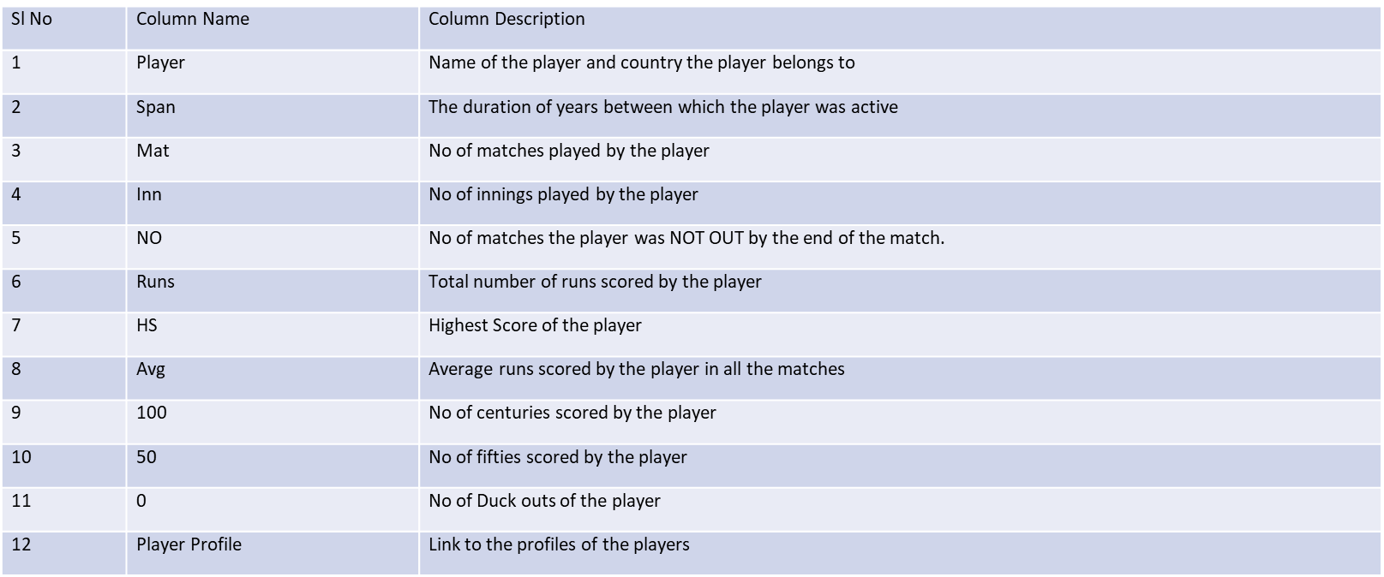
Data Set Description

Slide 4
Business Importance of Problem
This ICC project, will help in sports analytics in the following aspects –
Teams performance and Players Performance
Ad campaigning and Sponsorships
Player Performance Analysis and Historical Trends and Patterns
This Supply Chain project will help in the following aspects-
Inventory Management
Supplier Relationship Management
Order Fulfillment: Supply Chain Efficiency
Data-Driven Decision Making
Business Performance Analysis

Slide 5
Problem Definition
DATASET B :
Supply Chain
PROBLEM STATEMENT :
“Richard’s Supply” is a company which deals with different food products. The company is associated with a pool of suppliers. Every Supplier supplies different types of food products to Richard’s supply.
This company also receives orders for the food products from various customers. Each order may have multiple products mentioned along with the quantity.
The company has been maintaining the database for 2 years.

Slide 6
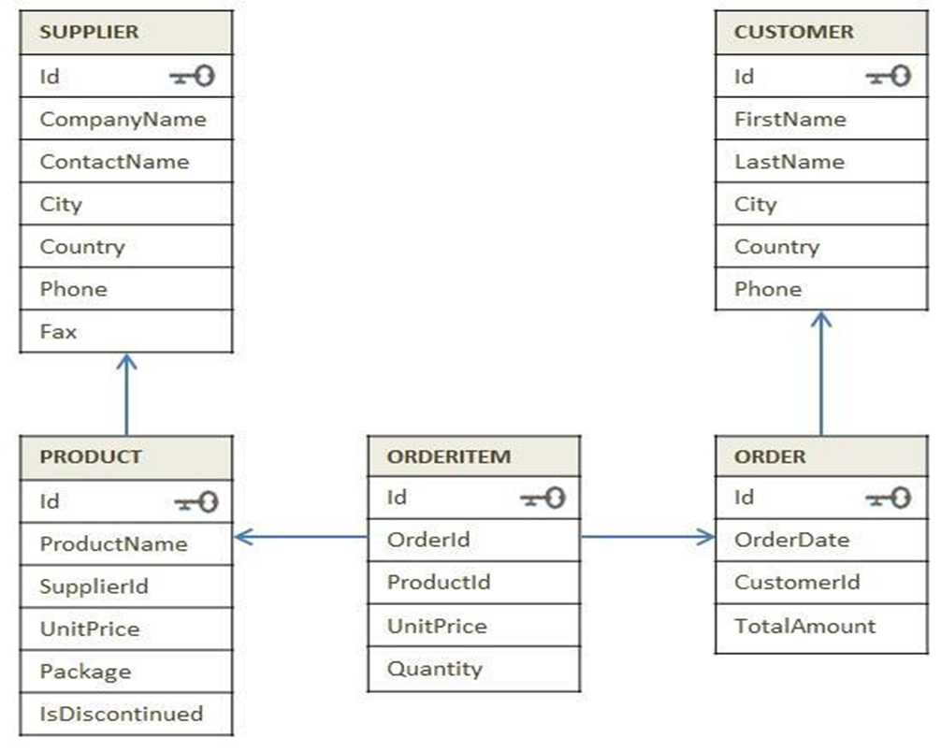
Data Set Description

Slide 7
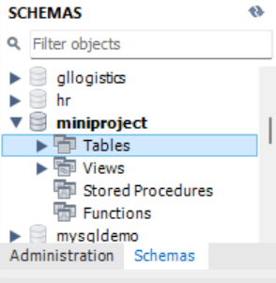
PART A Project Flow – Question 1
Write the question
Import the csv file to a table in the database.

Slide 8
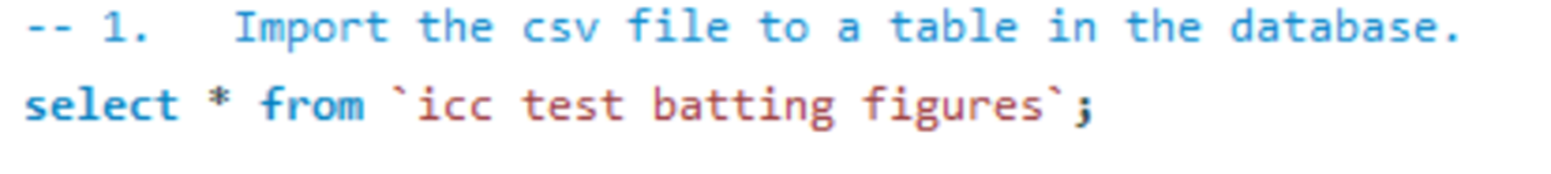
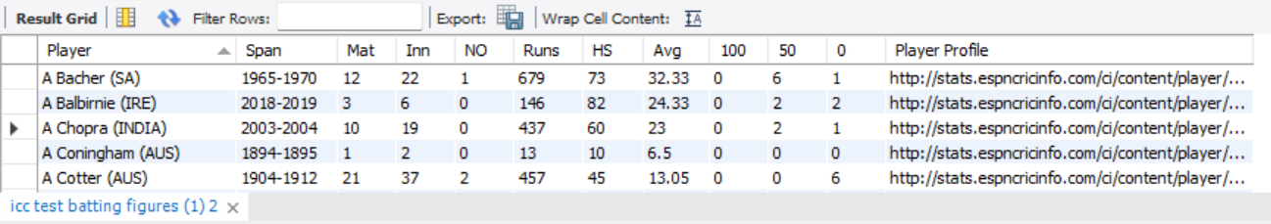
Code snippet
Solution :-

Slide 9
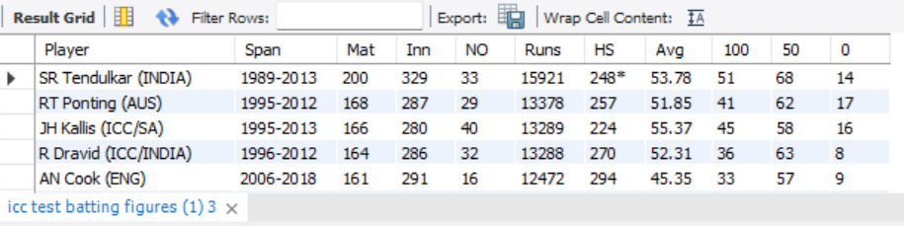
Project Flow – Question 2
Question
Remove the column 'Player Profile' from the table.
Code snippet:-
Solution:-

Slide 10
Project Flow – Question 3
Question
Extract the country name and player names from the given data and store it in separate columns for further usage.
Understanding:-
In the dataset ICC there is a column player which consists both the player name as well as the player’s country. Here we are splitting the player name and country Into two different columns.

Slide 11
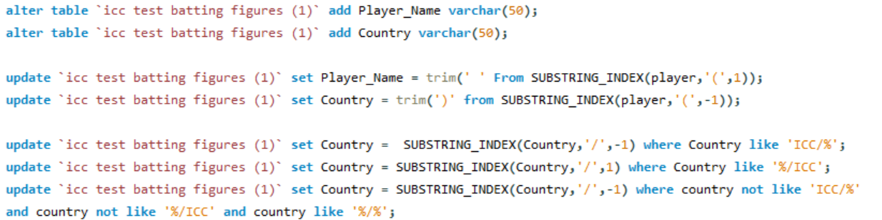
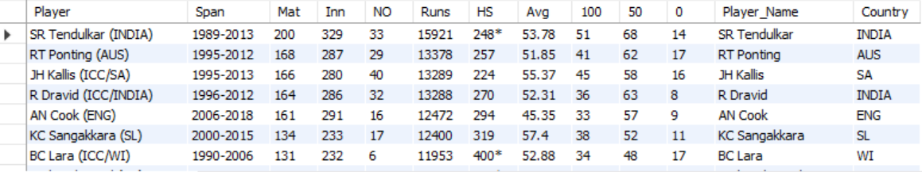
Code snippet:-
Solution:-

Slide 12
Project Flow – Question 4
Question
From the column 'Span' extract the start_year and end_year and store them in separate columns for further usage.
Understanding:-
In the dataset ICC there is a column span which consists both the start and end year of the player. Here we are splitting the player’s start and end year Into two different columns.

Slide 13
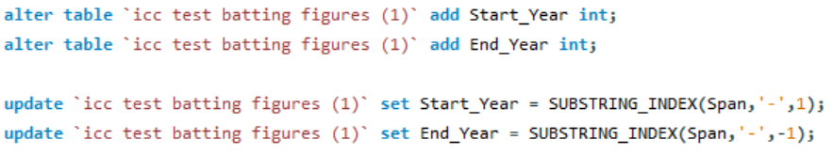
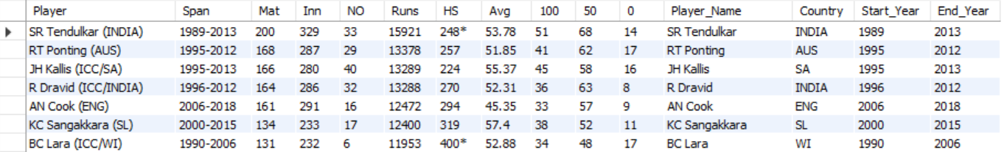
Code snippet:-
Solution:-

Slide 14
Project Flow – Question 5
Question
The column 'HS' has the highest score scored by the player so far in any given match. The column also has details if the player had completed the match in a NOT OUT status. Extract the data and store the highest runs and the NOT OUT status in different columns.
Understanding:-
The column HS consists the data of the player’s highest score as well as the player who are still playing the match. A new column is being added to the table which displays the status of the player.

Slide 15
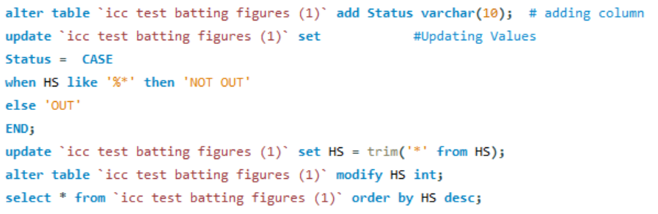
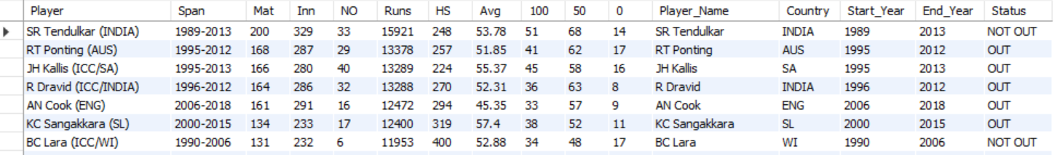
Code snippet:-
Solution:-

Slide 16
Project Flow – Question 6
Question
Using the data given, considering the players who were active in the year of 2019, create a set of batting order of best 6 players using the selection criteria of those who have a good average score across all matches for India.
Understanding:-
Here we are extracting best 6 players with highest average score who played for India in the year 2019.

Slide 17
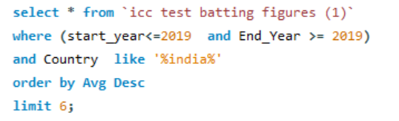
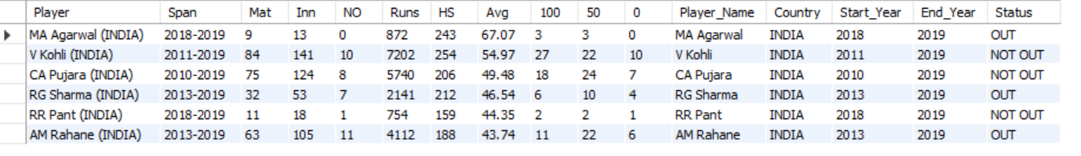
Code snippet:-
Solution:-

Slide 18
Project Flow – Question 7
Question
Using the data given, considering the players who were active in the year of 2019, create a set of batting order of best 6 players using the selection criteria of those who have the highest number of 100s across all matches for India.
Understanding:-
Here we are extracting best 6 players with highest number of centuries who played for India in the year 2019.

Slide 19
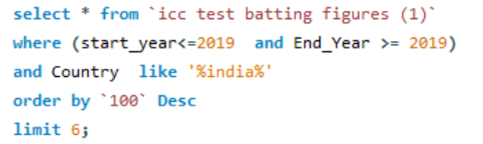
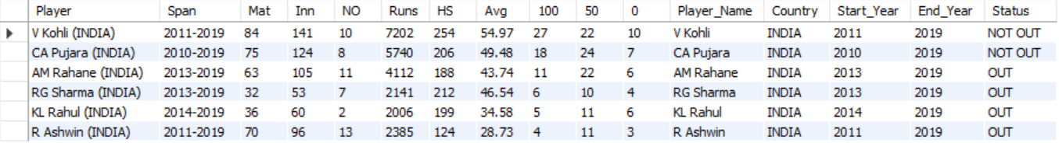
Code snippet:-
Solution:-

Slide 20
Project Flow – Question 8
Question
Using the data given, considering the players who were active in the year of 2019, create a set of batting order of best 6 players using 2 selection criteria of your own for India.
Understanding:-
Here we are extracting best 6 players who played for India in the year 2019 and
1st Selection Criteria - Runs must be more than 5000
2nd Selection Criteria – At-least Player must have 20 Centuries

Slide 21
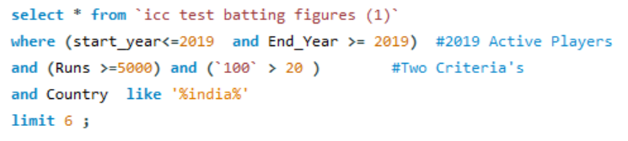
Code snippet:-
Solution:-

Slide 22
Project Flow – Question 9
Question
Create a View named ‘Batting_Order_GoodAvgScorers_SA’ using the data given, considering the players who were active in the year of 2019, create a set of batting order of best 6 players using the selection criteria of those who have a good average score across all matches for South Africa.
Understanding:-
Here we are creating a view by extracting best 6 players with highest average score who played for SA in the year 2019.

Slide 23
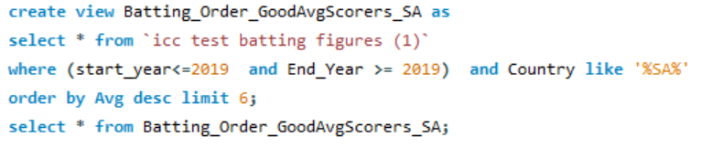
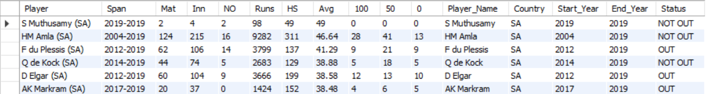
Code snippet:-
Solution:-

Slide 24
Project Flow – Question 10
Question
Create a View named ‘Batting_Order_HighestCenturyScorers_SA’ Using the data given, considering the players who were active in the year of 2019, create a set of batting order of best 6 players using the selection criteria of those who have highest number of 100s across all matches for South Africa.
Understanding:-
Here we are creating a view by extracting best 6 players with highest number of centuries who played for SA in the year 2019.

Slide 25
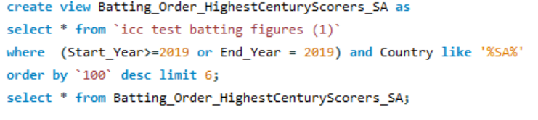
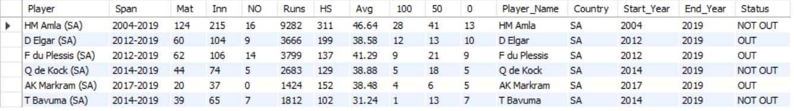
Code snippet:-
Solution:-

Slide 26
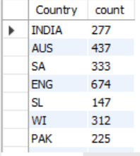
Project Flow – Question 11
Question
Using the data given, Give the number of player_played for each country.
Code snippet:-
Solution:-

Slide 27
Project Flow – Question 12
Question
Using the data given, Give the number of player_played for Asian and Non-Asian continent
Understanding:-
Firstly we are segregating the countries into Asian and Non-Asian continent and then counting the number of players belonging to the same.

Slide 28
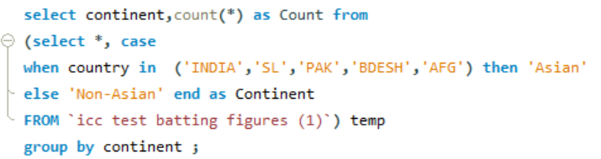
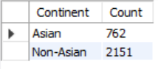
Code snippet:-
Solution:-

Slide 29
PART-B Project Flow – Question 13
Question
Company sells the product at different discounted rates. Refer actual product price in product table and selling price in the order item table. Write a query to find out total amount saved in each order then display the orders from highest to lowest amount saved.
Understanding:-
We are calculating the total amount saved in each order by subtracting the selling price from the actual product price, and then display the orders in descending order based on the amount saved.

Slide 30
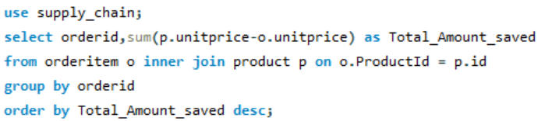
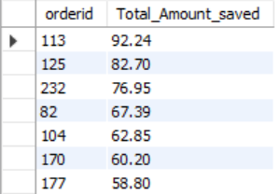
Code snippet:-
Solution:-

Slide 31
Project Flow – Question 14
Question
Mr. Kavin want to become a supplier. He got the database of "Richard's Supply" for reference. Help him to pick:
a. List few products that he should choose based on demand.
b. Who will be the competitors for him for the products suggested in above questions
Understanding:-
Based on the database of "Richard's Supply," we are assisting Mr. Kavin by listing high-demand products he should consider as a supplier and identify potential competitors for those products.

Slide 32
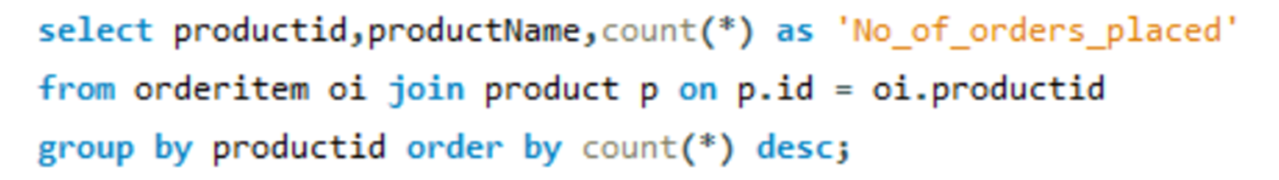
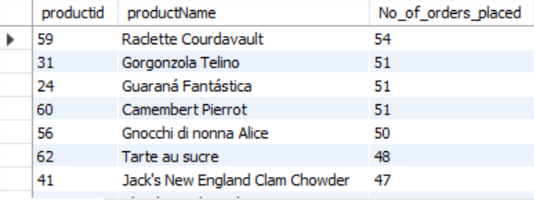
a. List few products that he should choose based on demand
Solution:-

Slide 33
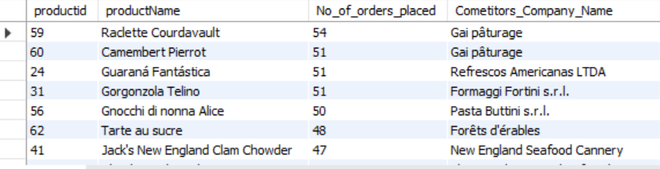
b. Who will be the competitors for him for the products suggested in above questions
Solution:-

Slide 34
Project Flow – Question 15
Question
Create a combined list to display customers and suppliers details considering the following criteria
a. Both customer and supplier belong to the same country
b. Customer who does not have supplier in their country
c. Supplier who does not have customer in their country

Slide 35
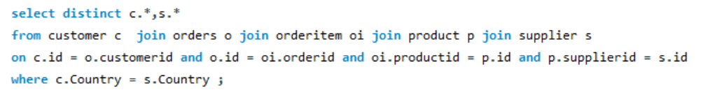
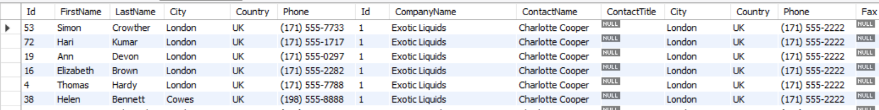
a. Both customer and supplier belong to the same country
Solution:-

Slide 36
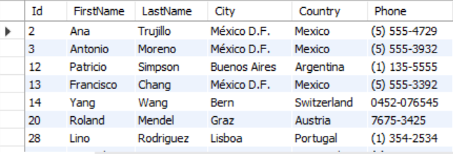
b. Customer who does not have supplier in their country
Solution:-

Slide 37
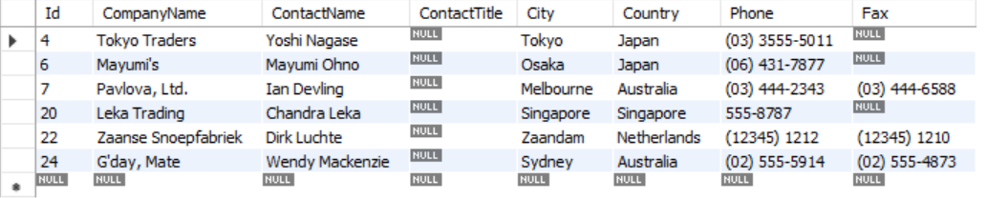
c. Supplier who does not have customer in their country
Solution:-

Slide 38
Project Flow – Question 16
Write the question
Every supplier supplies specific products to the customers. Create a view of suppliers and total sales made by their products and write a query on this view to find out top 2 suppliers (using windows function) in each country by total sales done by the products.
Question understanding:-

Slide 39
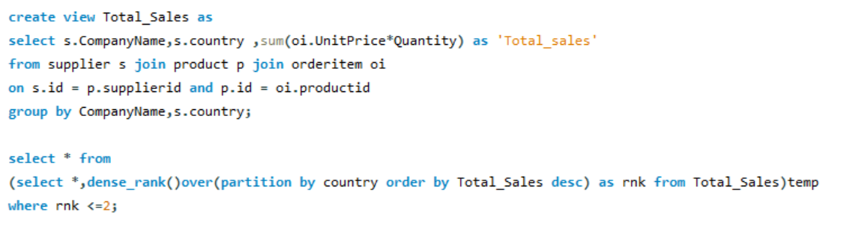
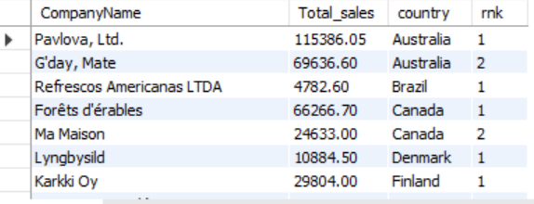
Code snippet:-
Solution:-

Slide 40
Project Flow – Question 17
Question
Find out for which products, UK is dependent on other countries for the supply. List the countries which are supplying these products in the same list.
Understanding:-
Here we are identifying the products for which the UK is reliant on other countries for the supply, and provide a list of the countries that are supplying these products in a combined list.

Slide 41
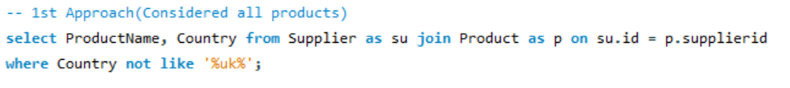
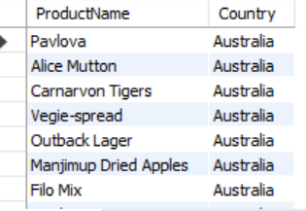
Code snippet of approach1:-
Solution:-

Slide 42
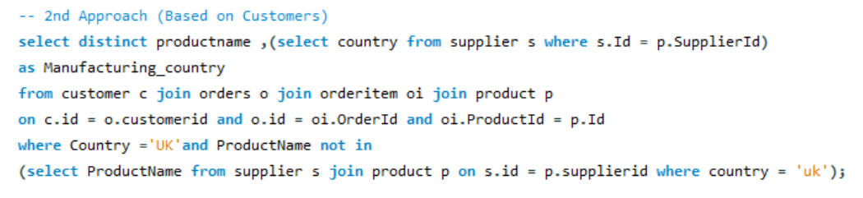
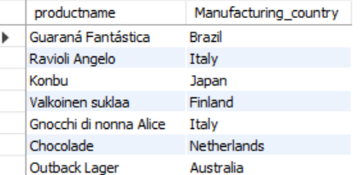
Code snippet of approach 2:-
Solution:-

Slide 43
Project Flow – Question 18
Question
Create two tables as ‘customer’ and ‘customer_backup’ as follow -
‘customer’ table attributes - Id, FirstName, LastName, Phone
‘customer_backup’ table attributes - Id, FirstName, LastName, Phone
Create a trigger in such a way that It should insert the details into the ‘customer_backup’ table when you delete the record from the ‘customer’ table automatically.

Slide 44
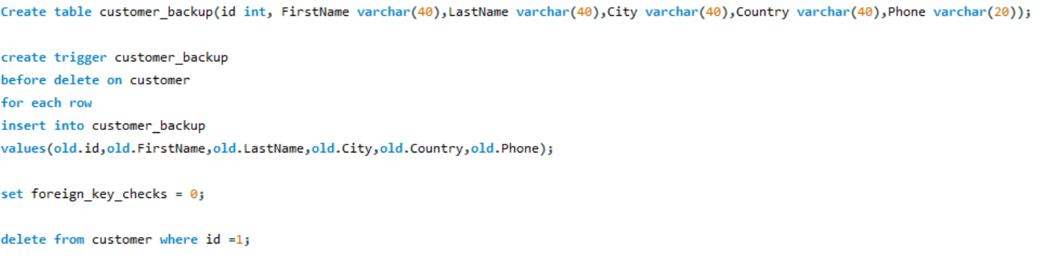
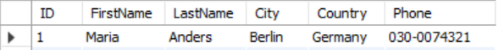
Code snippet:-
Solution:-

Slide 45
Major Challenge
In Part A usage of substring_index and trimming for the required output .
In Part B question no.5 due to multiple perspectives to the question we presented two approaches.

Slide 46
Conclusions
The skills learnt doing this mini project are:-
Learnt usage of substring_indexs.
Learnt usage of trim.
implementation of window functions, sub-queries.
Developing the ability to write complex SQL queries to retrieve, update, and manipulate data in a database.
Coordinating tasks within the team, assigning roles and responsibilities, and ensuring that everyone is aligned with the project goals.

Slide 47
THANK YOU

